Slide 1
DWDM MINI PROJECT
By Aakash Varma. A

Slide 2
Crop and Fertilizer Analysis
Functionalities used:
1) Apriori algorithm – Using Apriori algorithm to generate frequent itemset and association rules on different crops grown in the districts of Kerala
2) Decision tree classifier – Fertilizer analysis using decision tree classifier

Slide 3
DATASETS
Dataset of district wise crop production in Kerala for generating frequent item sets and for generating association rules.(Source – data.gov.in)
Fertilizer prediction dataset to predict fertilizer based on soil type ,crop type ,etc. (Source- kaggle.com)

Slide 4
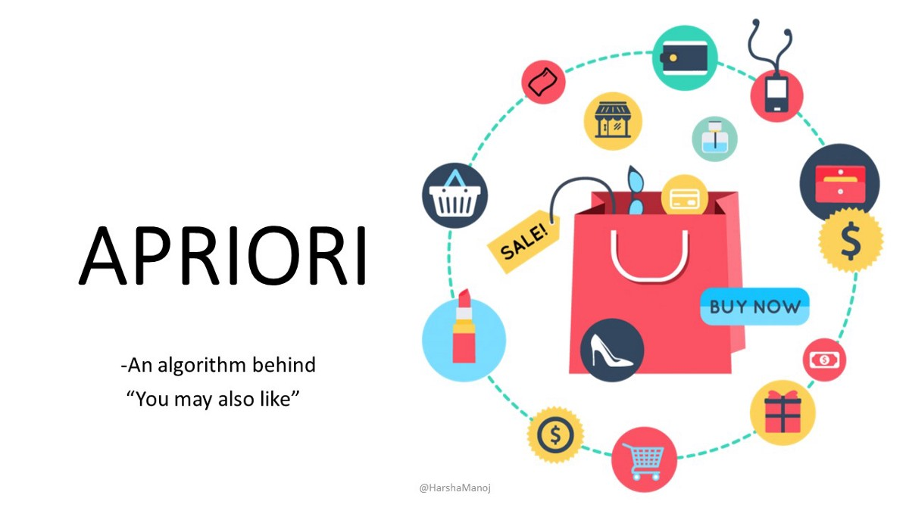

Slide 5
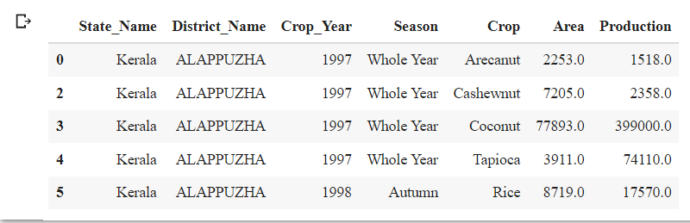
Dataset manipulation
Original dataset:

Slide 6
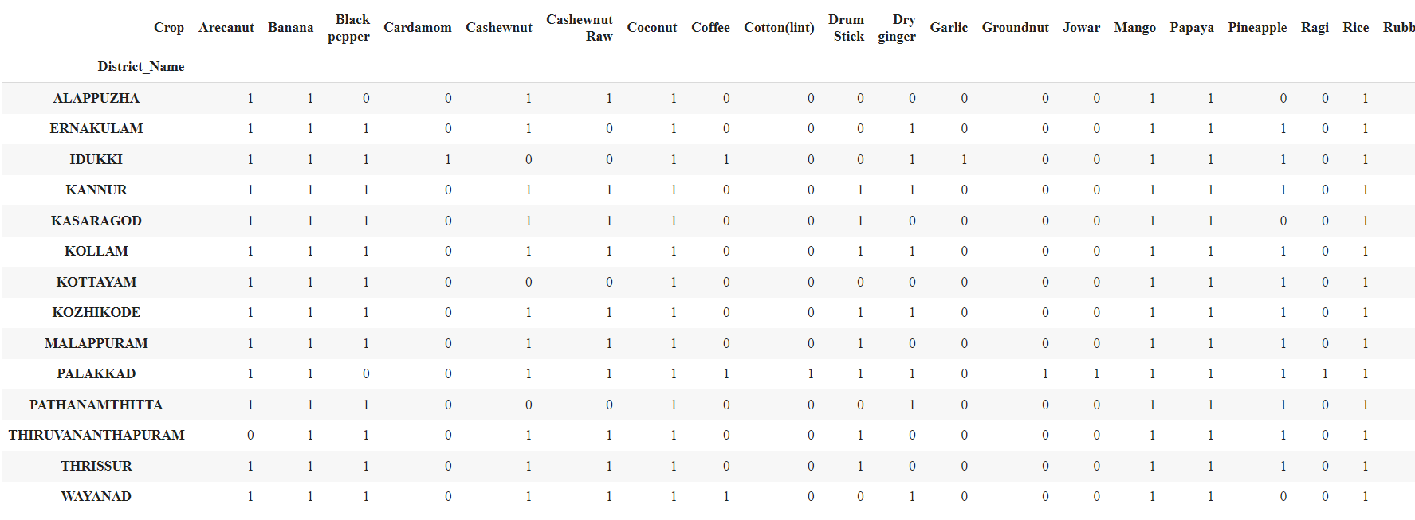
Converting into Transactional dataset

Slide 7
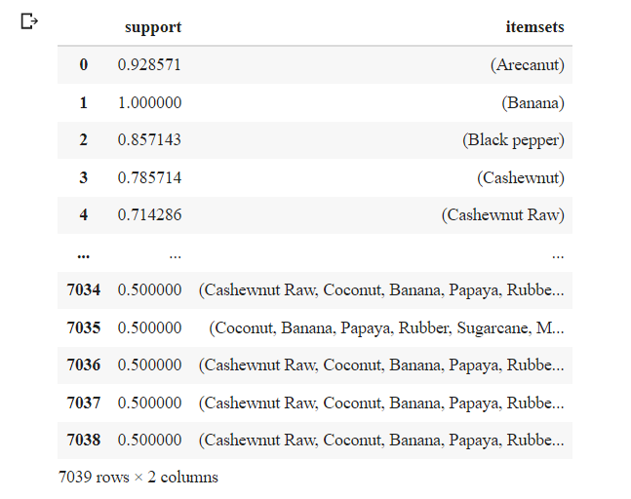
Using Apriori to form frequent item sets
Minimum support used = 0.5

Slide 8
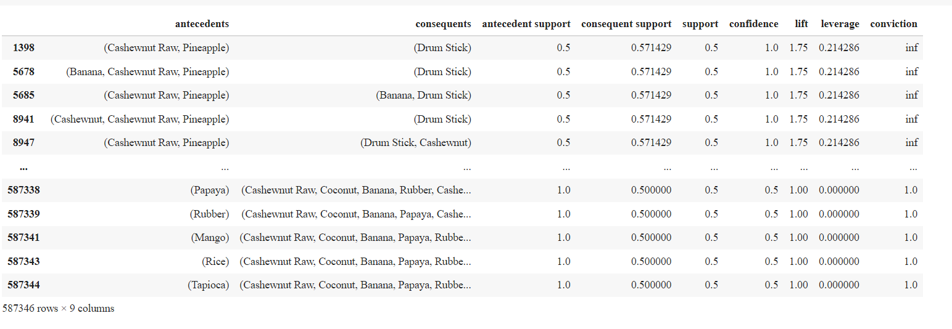
Association Rule mining

Slide 9
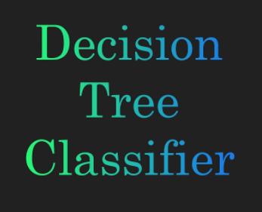

Slide 10
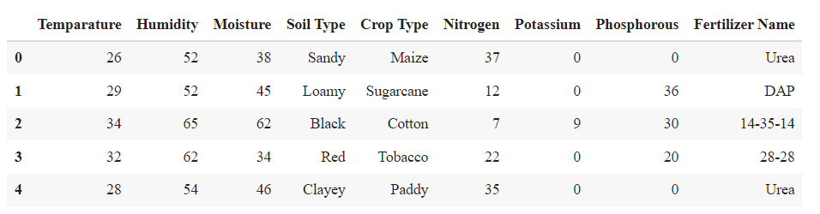
Fertilizer prediction dataset
Using head() function – 1st 5 rows

Slide 11
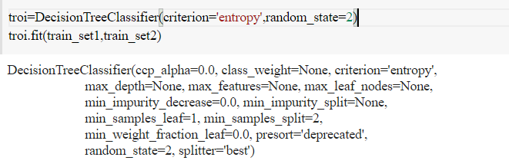
Forming Decision tree using entropy method:

Slide 12
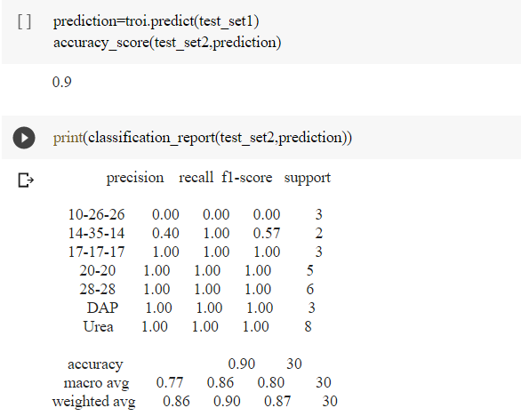
Accuracy prediction:
Accuracy obtained- 90%

Slide 13
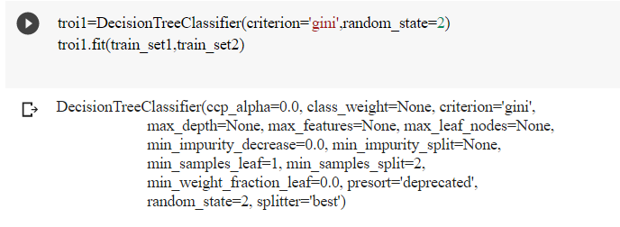
Forming decision tree using Gini index method

Slide 14
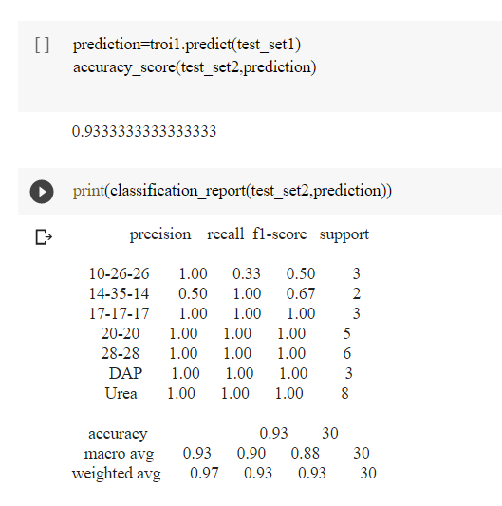
Accuracy prediction:
Accuracy obtained- 93%

Slide 15


